Slide 1
Analysis of health education’s impact in the context of global pandemics
Meera Al Khazraji (ma6603)
Shadad Hossain (mfh9822)
Jennifer Zheng (lz2278)
Ahmed Zoghbor(az1700)

Slide 2
Introduction & Background
In the current global pandemic climate, nearly every aspect of human life is impacted, including public health, the economy, politics, etc. It is not the first time that humans have faced the threat of infectious diseases in this century.
Nature: Baker et al. (2021): Infectious disease in an era of global change
“The twenty-first century has witnessed a wave of severe infectious disease outbreaks, not least the COVID-19 pandemic, which has had a devastating impact on lives and livelihoods around the globe.”
“The 2003 severe acute respiratory syndrome coronavirus outbreak, the 2009 swine flu pandemic, the 2012 Middle East respiratory syndrome coronavirus outbreak, the 2013–2016 Ebola virus disease epidemic in West Africa and the 2015 Zika virus disease epidemic all resulted in substantial morbidity and mortality while spreading across borders to infect people in multiple countries.”
Boutayeb, A., Boutayeb, S. & Boutayeb, W. Multi-morbidity of non communicable diseases and equity in WHO Eastern Mediterranean countries
“One of the biggest challenges currently facing humanity is chronic diseases which are sweeping the entire globe, with an increasing trend in developing countries [1]. Of the 57 million deaths that occurred worldwide in 2008, about 36 million (63%) were due to non communicable diseases.”

Slide 3
Motivations
Better Education → Better Health
Therefore, we wonder if this could be applied under the epidemic case
We want to investigate the possible actions or things to notice to protect people from infectious diseases, or to put it another way, what are the factors that will determine the mortality rate caused by pandemics?
Archive of Public Health: Raghuoathi (2020): The influence of education on health: an empirical assessment of OECD countries for the period 1995–2015
“People who are well educated experience better health as reflected in the high levels of self-reported health and low levels of morbidity, mortality, and disability. By extension, low educational attainment is associated with self-reported poor health, shorter life expectancy, and shorter survival when sick.”
Better Education = Better Health = Lower Mortality Rate caused by communicable diseases

Slide 4
Research
In addition, we found that the education also has a significant effect on the health behavior and awareness of individuals.
Hahn, Robert A, and Benedict I Truman. “Education Improves Public Health and Promotes Health Equity.”
“Public health policy makers, health practitioners and educators, and departments of health and education can collaborate to implement educational programs and policies for which systematic evidence indicates clear public health benefits.”
“Analysis of a representative survey of adults aged >25 years between 1990 and 2000 indicates that the prevalence of several risk behaviors is generally higher among those with fewer than nine years of formal education, begins to decline among those who have nine to 12 years of formal education, and continues to decline with additional years of education; this finding corresponds to the recognized importance of high school completion for subsequent health”

Slide 5
Empirical Strategy
In our statistical analysis, we will be gathering the data from those four indicators:
Government expenditure on education % GDP
Education Enrolment ( Primary, Secondary, Tertiary)
Health Behavior ( Immunization, Alcohol consumption, Basic Sanitization, etc).
Mortality Rate (Communicable disease)
Meta Data
GDP
Population
Government expenditure on education → Education Level → Health behavior → Mortality Rate (specifically related to communicable diseases)
Notes:
that is spread from one person to another through a variety of ways that include: contact with blood and bodily fluids; breathing in an airborne virus; or by being bitten by an insect.

Slide 6
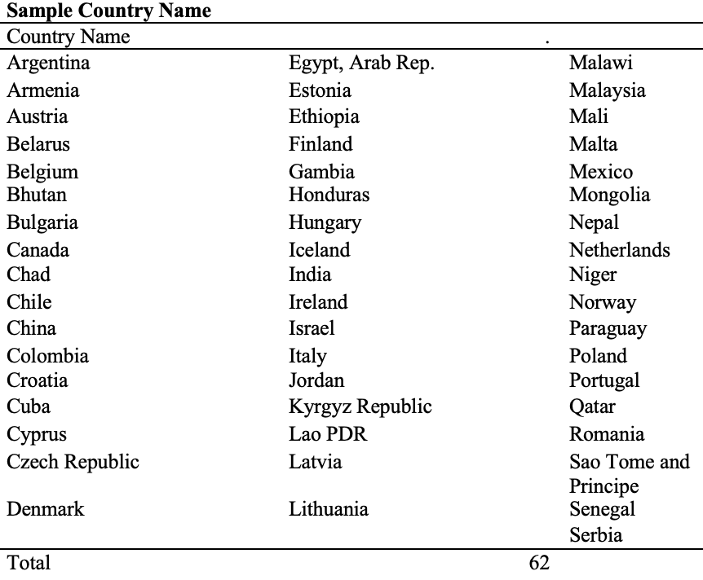
Sample Data
Extract data from world data bank on the year of 2010
Drop the observation with missing data
Got a sample of 62 observations

Slide 7
Variable | Obs | Mean | Std. Dev.
Mortality Rate | 62 | 16.3 | 20.1
Government Expenditure(%GDP) | 62 | 5.0 | 1.8
School Enrollment~primary | 62 | 102.4 | 12.3
School Enrollment~secondary | 62 | 86.6 | 27.6
School Enrollment~tertiary | 62 | 48.0 | 27.6
Immunization~DPT | 62 | 91.1 | 11.5
Immunization~Measle | 62 | 90.6 | 11.0
Alcoholic Consumption | 62 | 8.1 | 4.4
Basic Sanitization | 62 | 81.0 | 27.3
Safely Managed Sanitization | 62 | 59.5 | 27.8
GDP Data 2010 (transformed into billion) | 62 | 400.2 | 901.7
Population Total 2010 (transformed into million) | 62 | 60.1 | 227.1
Descriptive Statistics
Dependent Variable
Interested statistics (Expenditure on Edu)
Education
Health Behavior
Meta Data

Slide 8
Hypotheses
Ho: There is no significant relationship between government expenditure on education and mortality rate caused by communicable diseases.
Ha: There is significant relationship between government expenditure on education and mortality rate caused by communicable diseases.

Slide 9
Model 1
Mortality_Rate = β₁ x Govt_Expenditure_on_Edu + α + Є_{i}
Dependent variable - Mortality rate by communicable disease
Independent variable - Government expenditure on education %GDP

Slide 10
Model 2
Mortality_Rate = β₁ x Govt_Expenditure_on_Edu + β₂ x Education Enrollment + α + Є_{i}
Dependent variable - Mortality rate by communicable disease
Independent variable:
Government expenditure on education %GDP
Primary school enrollment
Secondary school enrollment
Tertiary school enrollment

Slide 11
Model 3
Mortality_Rate = β₁ x Govt_Expenditure_on_Edu + β₂ x Education Enrollment + β₃ x Health Behavior + α + Є_{i}
Dependent variable:
Mortality rate by communicable disease
Independent variable:
Government expenditure on education %GDP
Primary school enrollment
Secondary school enrollment
Tertiary school enrollment
Sanitization use
Immunization rate
Alcoholic consumption

Slide 12
Model 4 & 5
Model 4:
Weighted by Population → using [aw=Populationtotal] command
Makes the measurement by country to measurement by individual
Model 5:
Add in GDP of the countries to see if there is a significant change on result

Slide 13
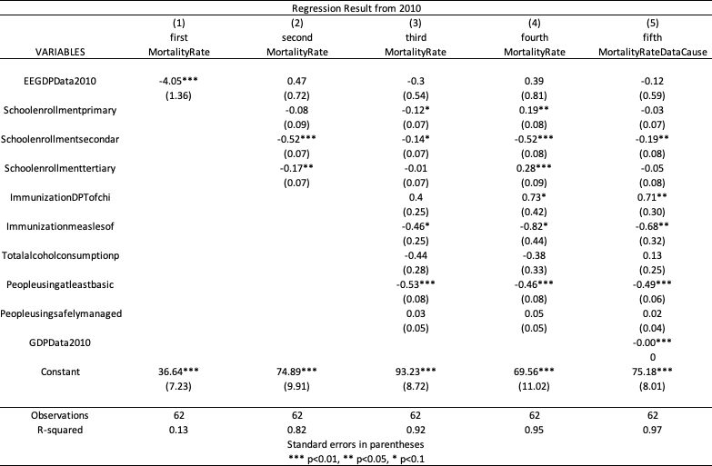

Slide 19
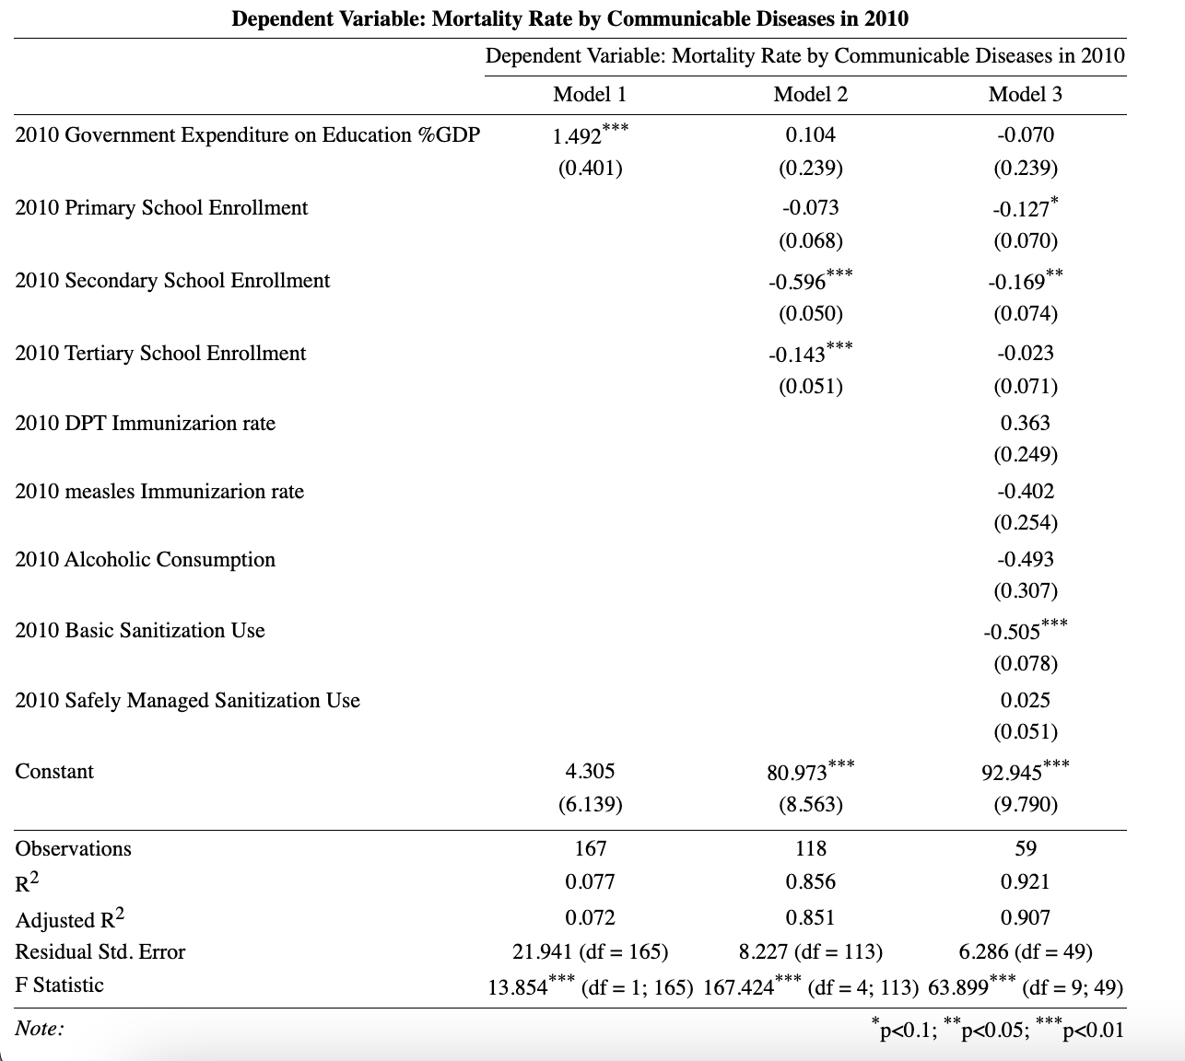
Analysis & Results
(2010) Model 1
P<0.01 → reject the null hypothesis, i.e., there is a statistically significant relationship
F statistic > critical F value → statistically significant
Due to the omitted variable bias, we are unable to determine whether the relationship is positive or negative or the degree of correlation between them.

Slide 20
Analysis & Results
(2010) Model 2
Only variables, tertiary and secondary enrollment, are statistically significant as their P values are less than .05
Secondary and tertiary education are affecting the model quite significantly as the absolute value of the gradients for these are higher compared to other variables.
The slope will be negative and Y intercept is 80.973.
The adjusted r2 value increase meaning a stronger correlation

Slide 21
Analysis & Results
(2010) Model 3
The adjusted R2 again increases, meaning a stronger relationship
Basic sanitization usage have a strong significant result
The basic sanitization usage has a value of -.505 which means it has the greatest influence.

Slide 22
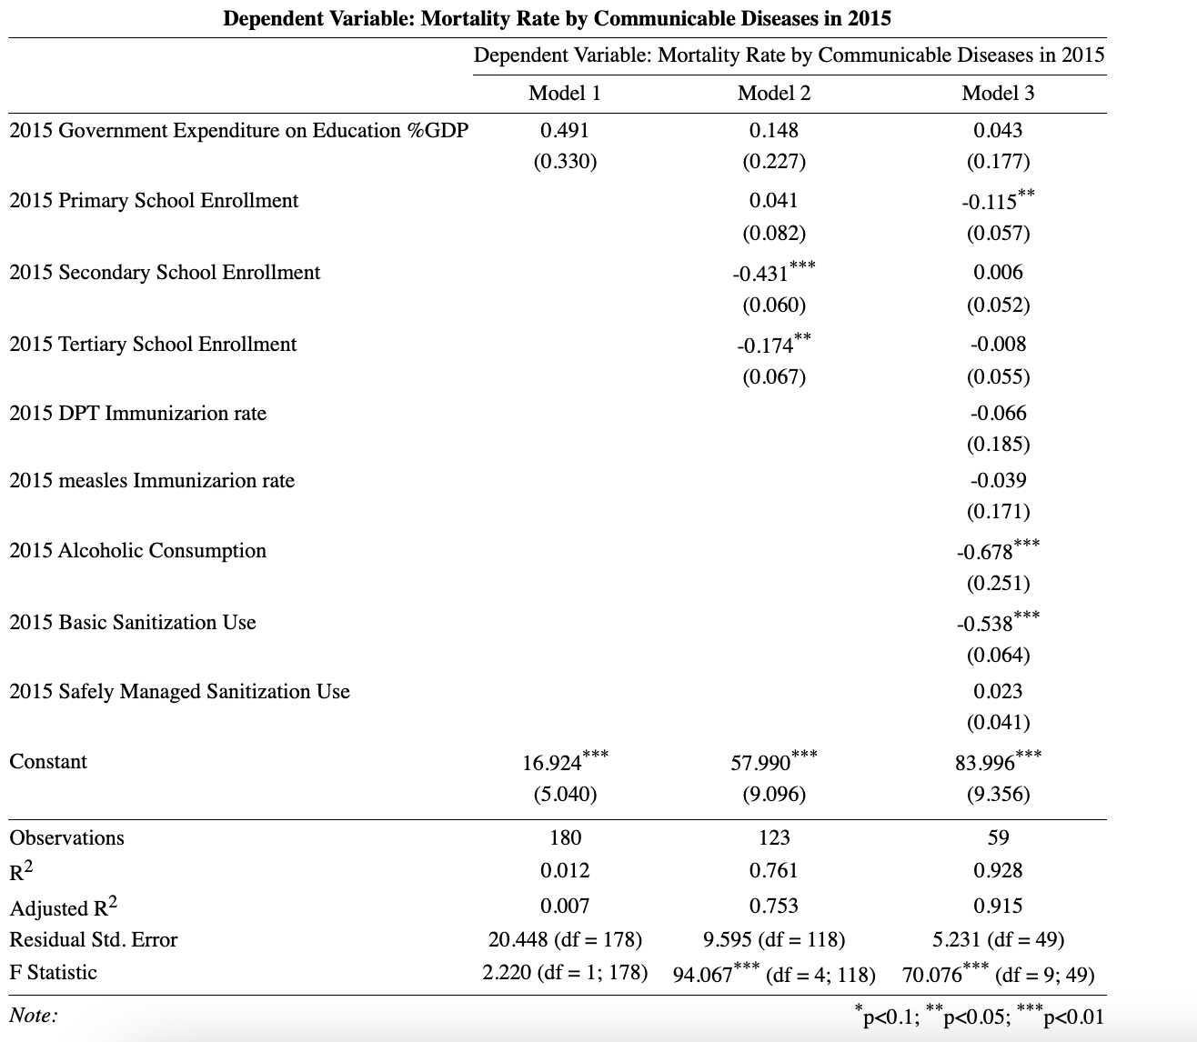
Analysis & Results
(2015) Model 1
P>0.1 → accept the null hypothesis, i.e., there is no statistically significant relationship
F statistic < critical F value → not statistically significant

Slide 23
Analysis & Results
(2015) Model 2
Only variables, tertiary and secondary enrollment, are statistically significant as their P values are less than .05 and 0.01
Secondary and tertiary education are affecting the model quite significantly as the absolute value of the gradients for these are higher compared to other variables.
The slope will be negative and Y intercept is 57.990.
The adjusted r2 value increase meaning a stronger correlation

Slide 24
Analysis & Results
(2015) Model 3
The adjusted R2 again increases, meaning a stronger relationship
Basic sanitization usage and alcoholic consumption have a strong significant result
The alcoholic consumption has a value of -.678 which means it has the greatest influence.

Slide 25
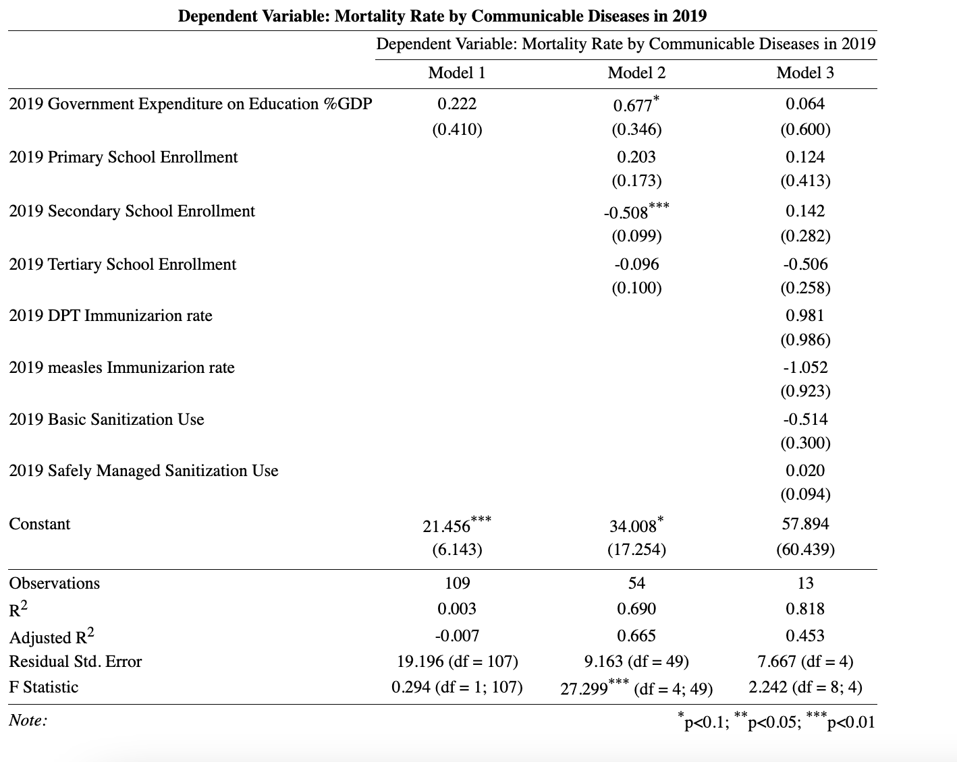
Analysis & Results
(2019) Model 1
P>0.1 → accept the null hypothesis, i.e., there is no statistically significant relationship
F statistic < critical F value → not statistically significant

Slide 26
Analysis & Results
(2019) Model 2
Only variables, secondary enrollment, are statistically significant as their P values are less than .01
Secondary is affecting the model quite significantly as the absolute value of the gradients for these are higher compared to other variables.
The slope will be negative and Y intercept is 34.008.
The adjusted r2 value increase meaning a stronger correlation

Slide 27
Analysis & Results
(2019) Model 3
The adjusted R2 again decreases, meaning a less strong relationship
No variable have a strong significant result

Slide 28
Conclusions & Limitations
Conclusions
We reject the null hypothesis
Findings → the expenditure on education has impact on the mortality rate caused by communicable diseases
Limitations
Data sample are limited
Year → we only picked one representative year
Country → We only have a sample of 62 countries
We were not able to find health education related data which could be more direct
The relationship might be reversed. The cause-and-effect relationship still needs further validations
We weren't able to obtain some COVID pandemic data that may have been more relevant to the current state of public health

Slide 29
Implications & Further Study
Further Study
If we have more time, we would like to validate the cause-and-effect relationship between our dependent and independent variables
We would also want to obtain health education relevant data to more closely and specifically examine the impact of health education.
Policy implications
For better protection against current pandemics, policy makers should increase investment in health education and basic sanitation services.

Slide 30
Works Cited
Baker, R.E., Mahmud, A.S., Miller, I.F. et al. Infectious disease in an era of global change. Nat Rev Microbiol 20, 193–205 (2022). https://doi.org/10.1038/s41579-021-00639-z
Boutayeb, A., Boutayeb, S. & Boutayeb, W. Multi-morbidity of non communicable diseases and equity in WHO Eastern Mediterranean countries. Int J Equity Health 12, 60 (2013). https://doi.org/10.1186/1475-9276-12-60
Hahn, Robert A, and Benedict I Truman. “Education Improves Public Health and Promotes Health Equity.” International journal of health services : planning, administration, evaluation vol. 45,4 (2015): 657-78. doi:10.1177/0020731415585986
Raghupathi, V., Raghupathi, W. The influence of education on health: an empirical assessment of OECD countries for the period 1995–2015. Arch Public Health 78, 20 (2020). https://doi.org/10.1186/s13690-020-00402-5
“World Development Indicators.” DataBank, The World Bank Group, 2022, https://databank.worldbank.org/source/world-development-indicators#.

Slide 31
Thank you!

